Slide 1
Alex Edwards, MSPH
Emory University School of Medicine
Materials Courtesy of: Mine Çetinkaya-Rundel

Slide 2


Slide 3
What we will not cover:

Slide 4
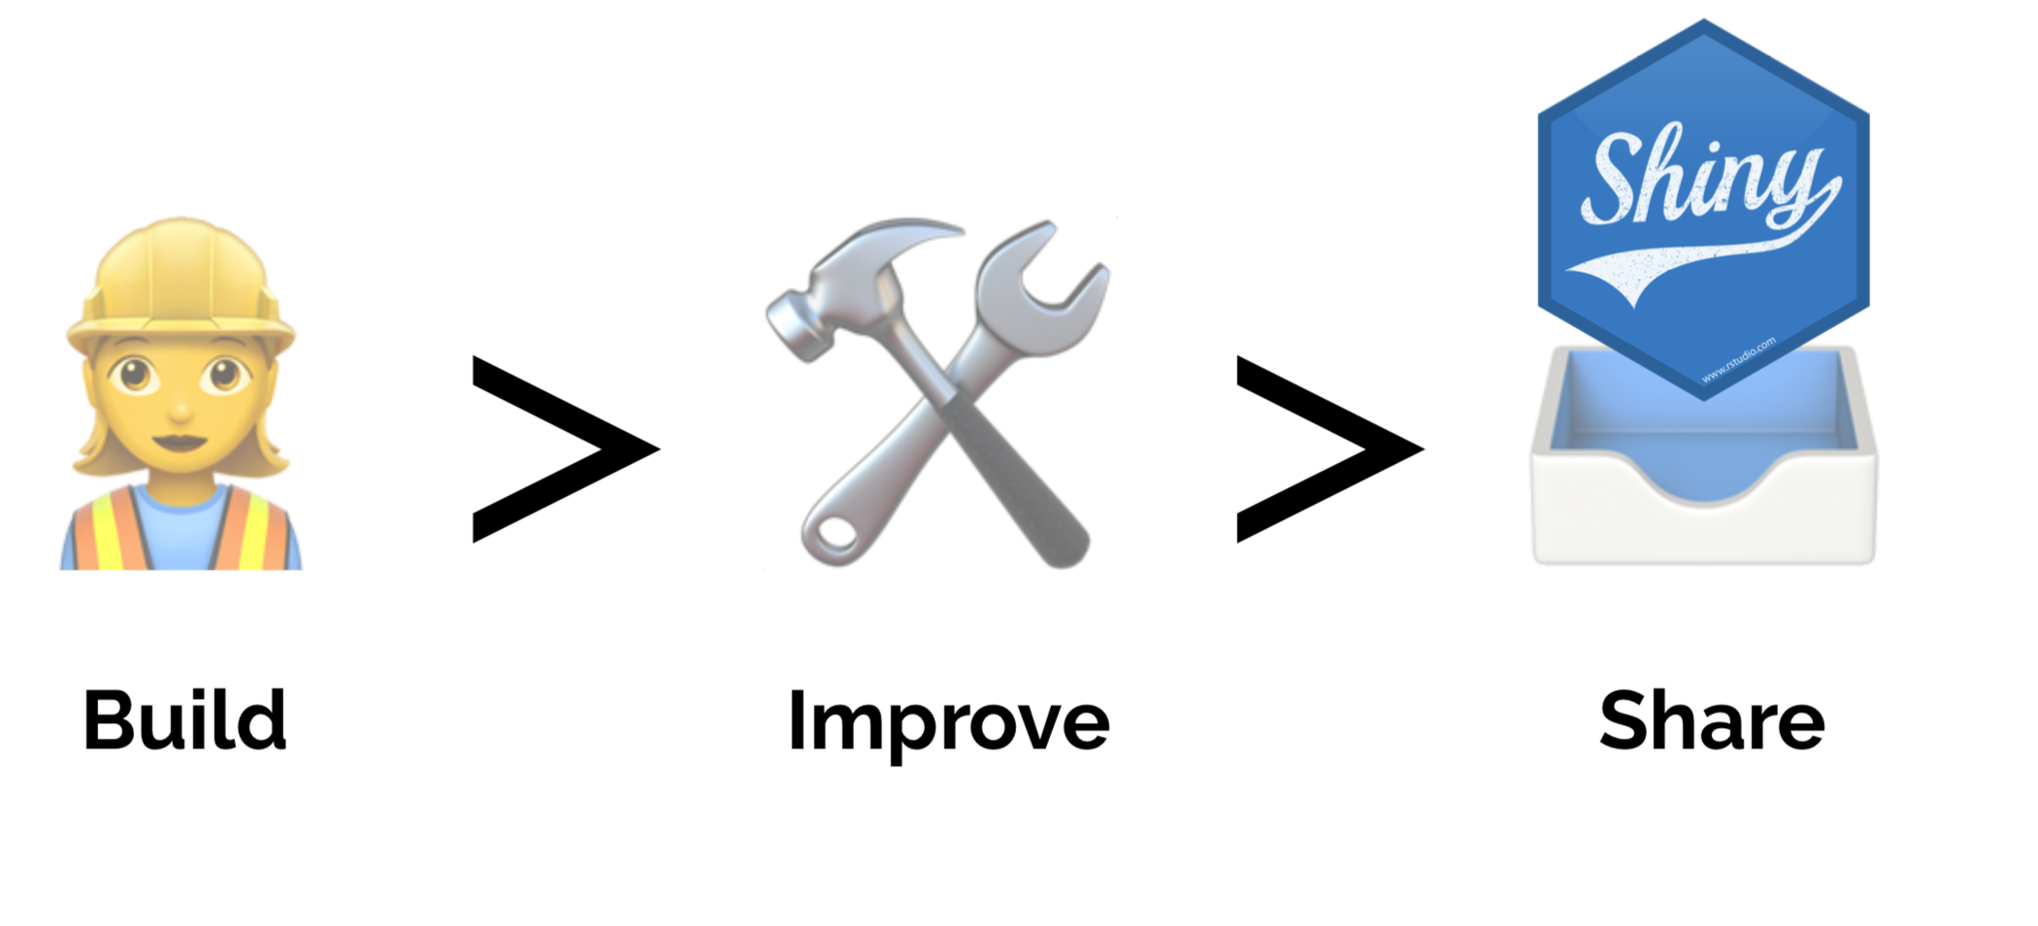
What we will cover:

Slide 5
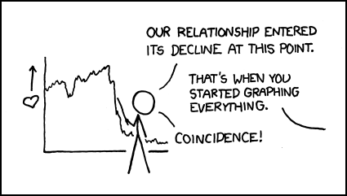
What Is A Good Graph:

Slide 6
What Is A Good Graph: A Counter Example

Slide 7
What Is A Good Graph: A Counter Example

Slide 8
What Is A Good Graph: A Counter Example

Slide 9
What Is A Good Graph: A Counter Example

Slide 10

goog-index/app.R
DEMO

Slide 11

Your turn
Open a new Shiny app with File ➔ New File ➔ Shiny Web App…
Launch the app by opening app.R and clicking Run App
Close the app by clicking the stop icon
Select view mode in the drop down menu next to Run App

Slide 12
High-level view

Slide 13


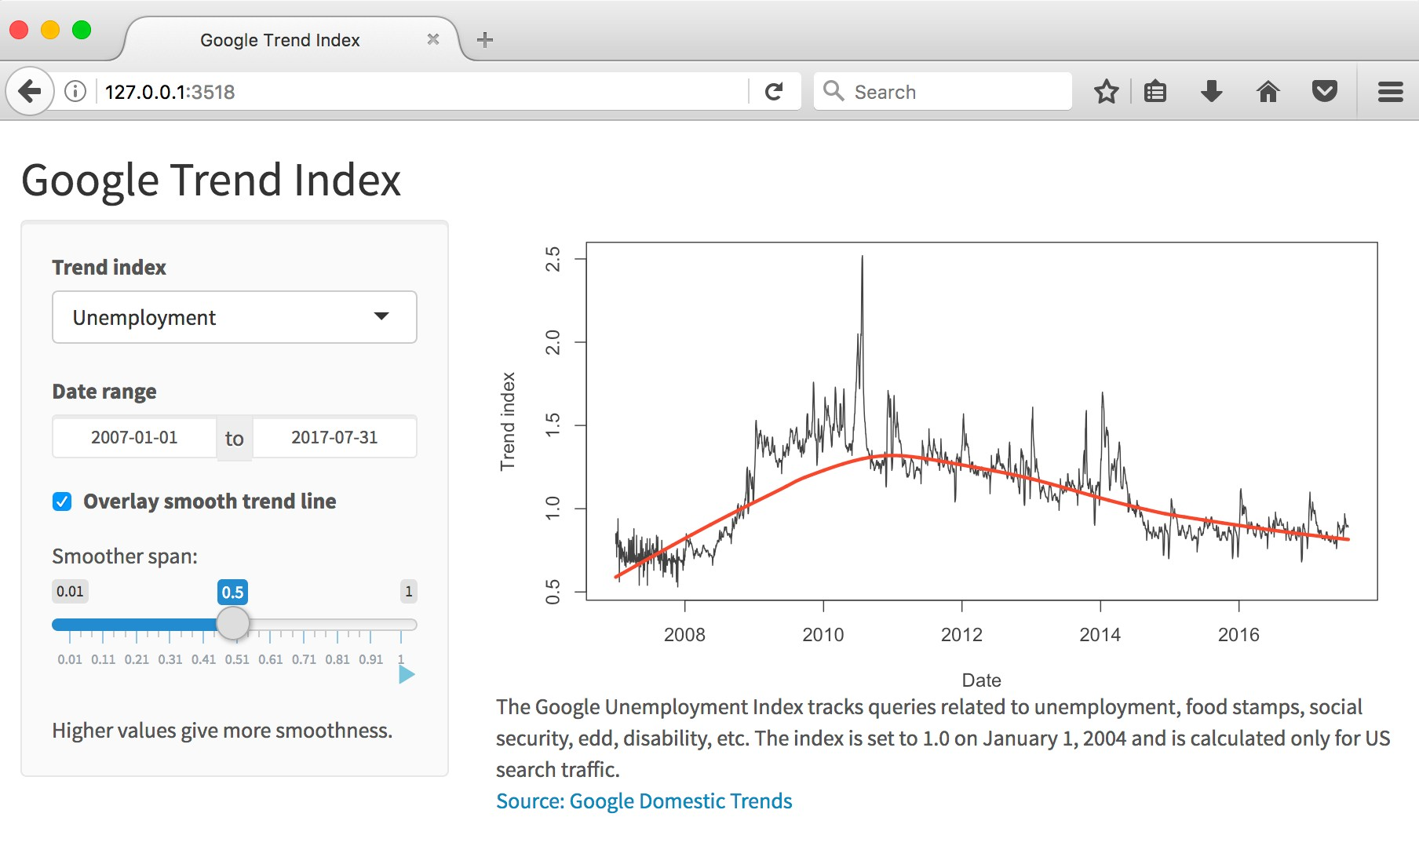
Every Shiny app has a webpage that the user visits, and behind this webpage there is a computer
that serves this webpage by running R.

Slide 14

When running your app locally,
the computer serving your app is your computer.

Slide 15

When your app is deployed,
the computer serving your app is a web server.

Slide 16


HTML
Server instructions
User interface

Slide 17
Anatomy of A Shiny App

Slide 18
What’s in an app?
library(shiny)
ui <- fluidPage()
User interface controls the layout and appearance of app
Server function contains instructions needed to build app
server <- function(input, output) {}
shinyApp(ui = ui, server = server)

Slide 19
NHANES::NHANES
Data from the 2009 - 2010 and 2011 - 2012 surveys on 10,000 participants and 76 variables collected on them

Slide 20
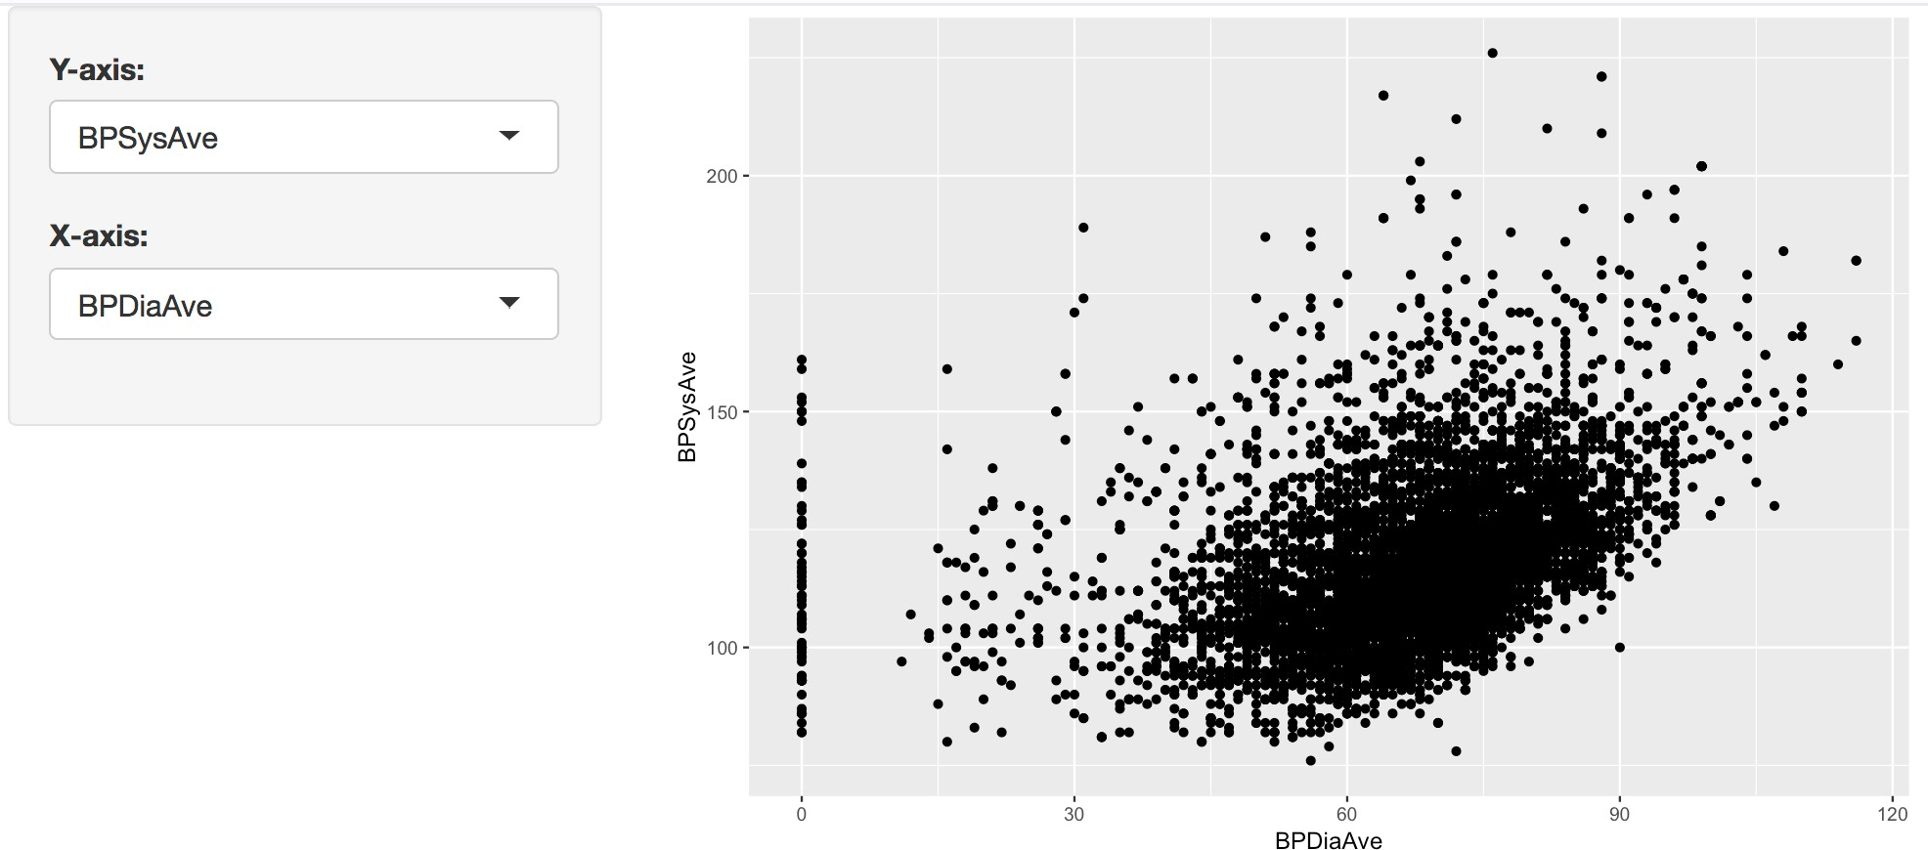

Slide 21
App template
library(shiny) library(tidyverse) library(NHANES)
ui <- fluidPage()
server <- function(input, output) {} shinyApp(ui = ui, server = server)

Slide 22
User interface

Slide 23
# Define UI
ui <- fluidPage(
# Sidebar layout with a input and output definitions sidebarLayout(
# Inputs: Select variables to plot sidebarPanel(
# Select variable for y-axis selectInput(inputId = "y", label = "Y-axis:",
choices = c("Age", "Poverty", "Pulse", "AlcoholYear", "BPSysAve"), selected = "BPSysAve"),
# Select variable for x-axis
selectInput(inputId = "x", label = "X-axis:",
choices = c("Age", "Poverty", "Pulse", "AlcoholYear", "BPSysAve"), selected = "BPDiaAve")
),
# Output: Show scatterplot mainPanel(
plotOutput(outputId = "scatterplot")
)
)

Slide 24
Create fluid page layout
# Define UI
ui <- fluidPage(
# Sidebar layout with a input and output definitions sidebarLayout(
# Inputs: Select variables to plot sidebarPanel(
# Select variable for y-axis
selectInput(inputId = "y", label = "Y-axis:",
choices = c("Age", "Poverty", "Pulse", "AlcoholYear", "BPSysAve"), selected = "BPSysAve"),
# Select variable for x-axis selectInput(inputId = "x", label = "X-axis:",
choices = c("Age", "Poverty", "Pulse", "AlcoholYear", "BPDiaAve"), selected = "BPDiaAve")
),
# Output: Show scatterplot mainPanel(
plotOutput(outputId = "scatterplot")
)
)
)

Slide 25
# Define UI
ui <- fluidPage(
# Sidebar layout with a input and output definitions sidebarLayout(
# Inputs: Select variables to plot sidebarPanel(
# Select variable for y-axis
selectInput(inputId = "y", label = "Y-axis:",
Create a layout with a sidebar and main area
choices = c("Age", "Poverty", "Pulse", "AlcoholYear", "BPSysAve"), selected = "BPSysAve"),
# Select variable for x-axis selectInput(inputId = "x", label = "X-axis:",
choices = c("Age", "Poverty", "Pulse", "AlcoholYear", "BPDiaAve"), selected = "BPDiaAve")
),
# Output: Show scatterplot mainPanel(
plotOutput(outputId = "scatterplot")
)
)
)

Slide 26
# Define UI
ui <- fluidPage(
# Sidebar layout with a input and output definitions sidebarLayout(
# Inputs: Select variables to plot
Create a sidebar panel containing input controls that can in turn be passed to sidebarLayout
sidebarPanel(
# Select variable for y-axis selectInput(inputId = "y", label = "Y-axis:",
choices = c("Age", "Poverty", "Pulse", "AlcoholYear", "BPSysAve"), selected = "BPSysAve"),
# Select variable for x-axis selectInput(inputId = "x", label = "X-axis:",
choices = c("Age", "Poverty", "Pulse", "AlcoholYear", "BPDiaAve"), selected = "BPDiaAve")
),
# Output: Show scatterplot mainPanel(
plotOutput(outputId = "scatterplot")
)
)
)

Slide 27
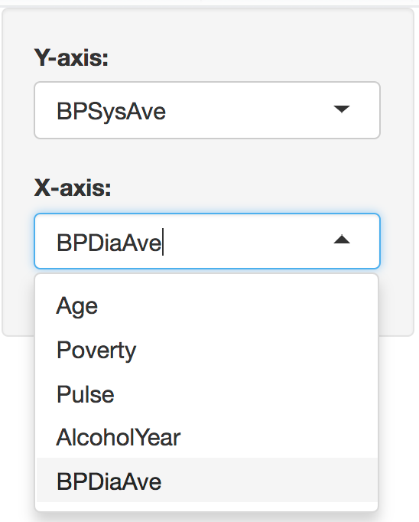
# Define UI
ui <- fluidPage(
# Sidebar layout with a input and output definitions sidebarLayout(
# Inputs: Select variables to plot sidebarPanel(
# Select variable for y-axis
selectInput(inputId = "y", label = "Y-axis:",
choices = c("Age", "Poverty", "Pulse", "AlcoholYear", "BPSysAve"), selected = "BPSysAve"),
# Select variable for x-axis selectInput(inputId = "x", label = "X-axis:",
choices = c("Age", "Poverty", "Pulse", "AlcoholYear", "BPDiaAve"), selected = "BPDiaAve")
),
# Output: Show scatterplot mainPanel(
plotOutput(outputId = "scatterplot")
)
)
)

Slide 28
# Define UI
ui <- fluidPage(
# Sidebar layout with a input and output definitions sidebarLayout(
# Inputs: Select variables to plot sidebarPanel(
# Select variable for y-axis
selectInput(inputId = "y", label = "Y-axis:", choices = c("Age", "Poverty", "Pulse", | "AlcoholYear", | "BPSysAve"),
selected = "BPSysAve"),
# Select variable for x-axis selectInput(inputId = "x", label = "X-axis:",
choices = c("Age", "Poverty", "Pulse", selected = "BPDiaAve") | "AlcoholYear", | "BPDiaAve"),
),
Create a main panel containing output elements that get created in the server function can in turn be passed to sidebarLayout
# Output: Show scatterplot mainPanel(
plotOutput(outputId = "scatterplot")
)
)
)

Slide 29
Server

Slide 30
# Define server function
server <- function(input, output) {
# Create the scatterplot object the plotOutput function is expecting output$scatterplot <- renderPlot({
ggplot(data = NHANES, aes_string(x = input$x, y = input$y)) + geom_point()
})
}

Slide 31
Contains instructions needed to build app
# Define server function
server <- function(input, output) {
# Create the scatterplot object the plotOutput function is expecting output$scatterplot <- renderPlot({
ggplot(data = NHANES, aes_string(x = input$x, y = input$y)) + geom_point()
})
}

Slide 32
# Define server function
server <- function(input, output) {
# Create the scatterplot object the plotOutput fu output$scatterplot <- renderPlot({
ggplot(data = NHANES, aes_string(x = input$x, y geom_point()
})
}
Renders a reactive plot that is suitable for assigning to an output slot
nction is expecting
= input$y)) +

Slide 33
# Define server function
server <- function(input, output) {
# Create the scatterplot object the plotOutput function is expecting output$scatterplot <- renderPlot({
ggplot(data = NHANES, aes_string(x = input$x, y = input$y)) + geom_point()
})
Good ol’ ggplot2 code, with inputs from UI
}

Slide 34
UI + Server

Slide 35
# Create the Shiny app object shinyApp(ui = ui, server = server)

Slide 36
Putting it all together…
nhanes-apps/nhanes-01.R
DEMO

Slide 37
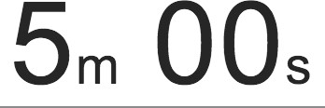
Your turn
Add new select menu to color the points by
inputId = "z"
label = "Color by:"
choices = c("Gender", "Depressed", "SleepTrouble",
"SmokeNow", "Marijuana")
selected = "SleepTrouble"
Use this variable in the aesthetics of the ggplot function as the color argument
to color the points by
Run the app in the Viewer Pane
Compare your code / output with the person sitting next to / nearby you

Slide 38
Solution to the previous exercise
nhanes-apps/nhanes-02.R
SOLUTION

Slide 39
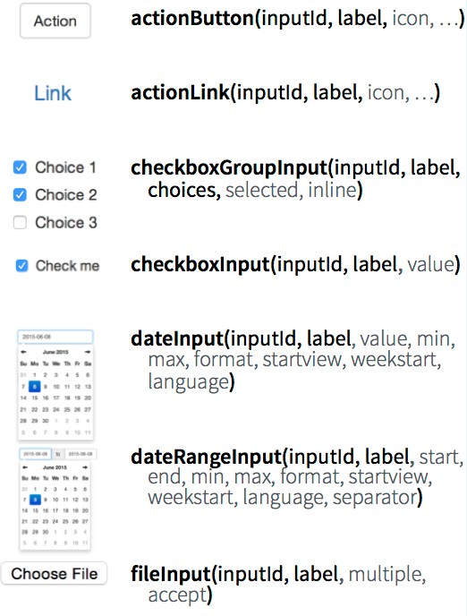
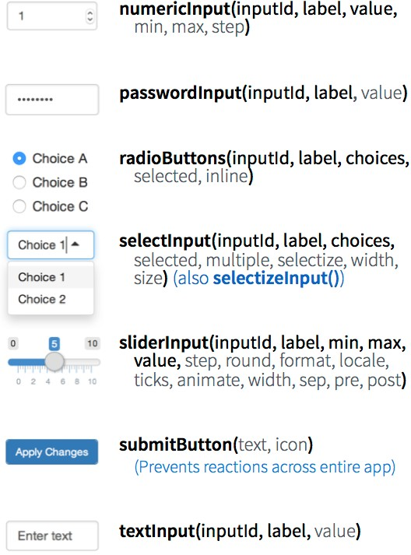
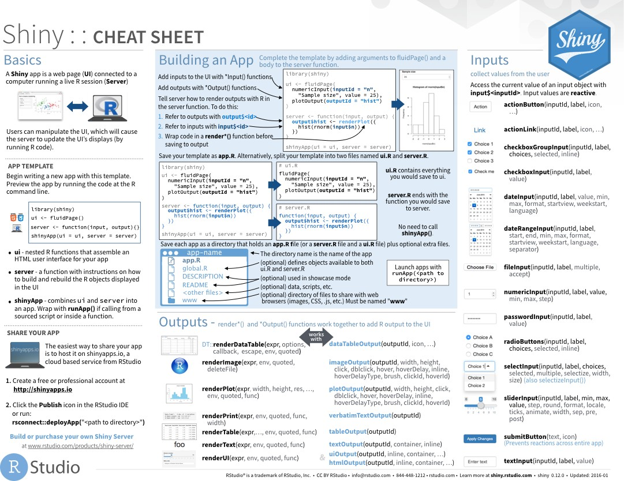
Inputs

Slide 40
Your turn
Add new input variable to control the alpha level of the points
This should be a sliderInput
- See shiny.rstudio.com/reference/shiny/latest/ for help
Values should range from 0 to 1
Set a default value that looks good
Use this variable in the geom of the ggplot function as the alpha argument
Run the app in a new window
Compare your code / output with the person sitting next to / nearby you

Slide 41
Solution to the previous exercise
nhanes-apps/nhanes-03.R
SOLUTION

Slide 42
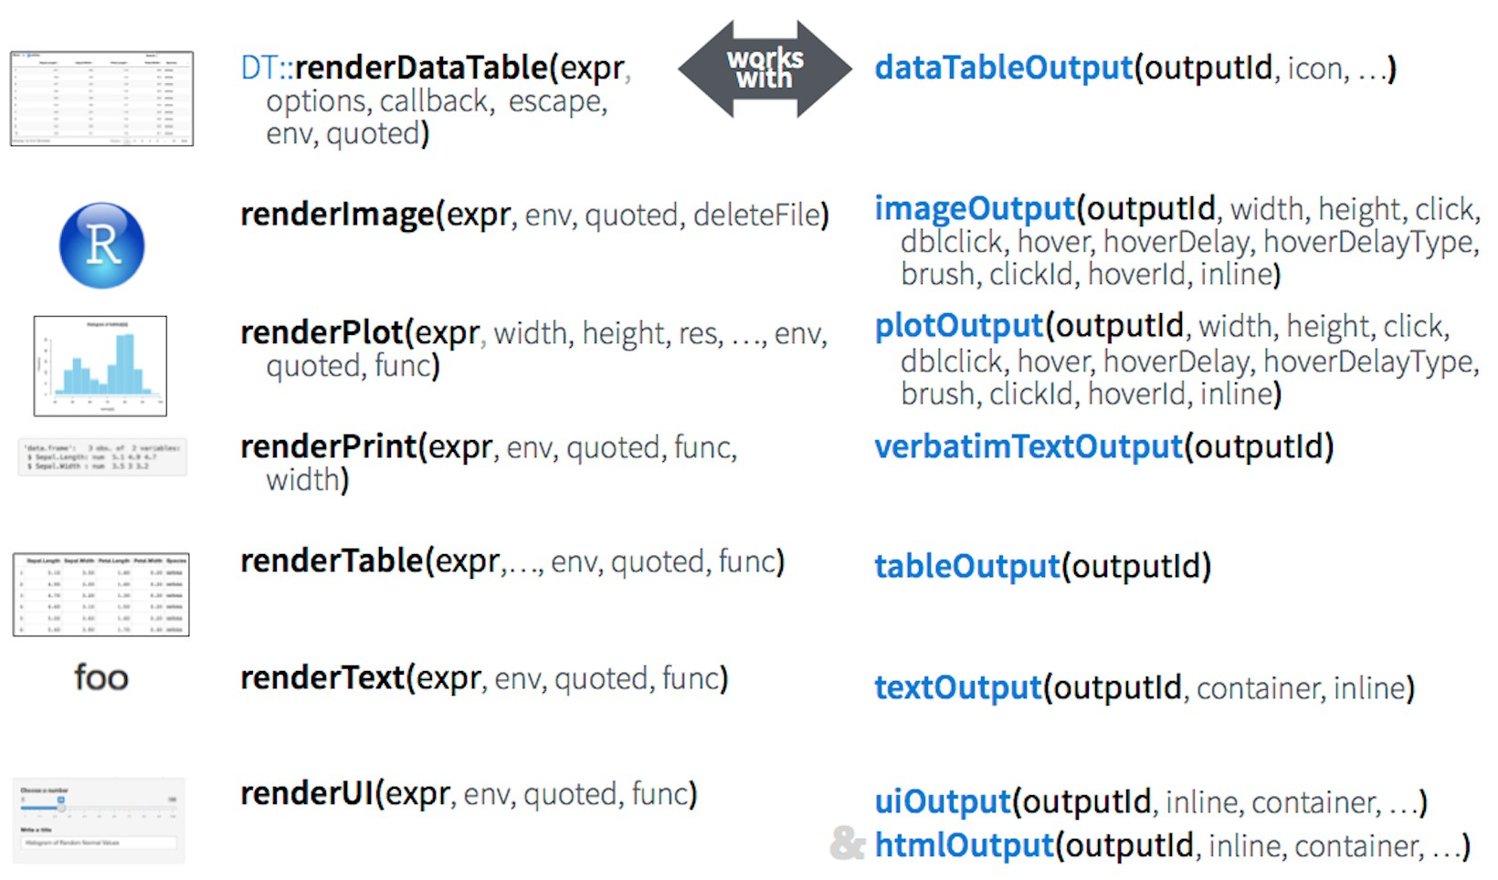
Outputs

Slide 43
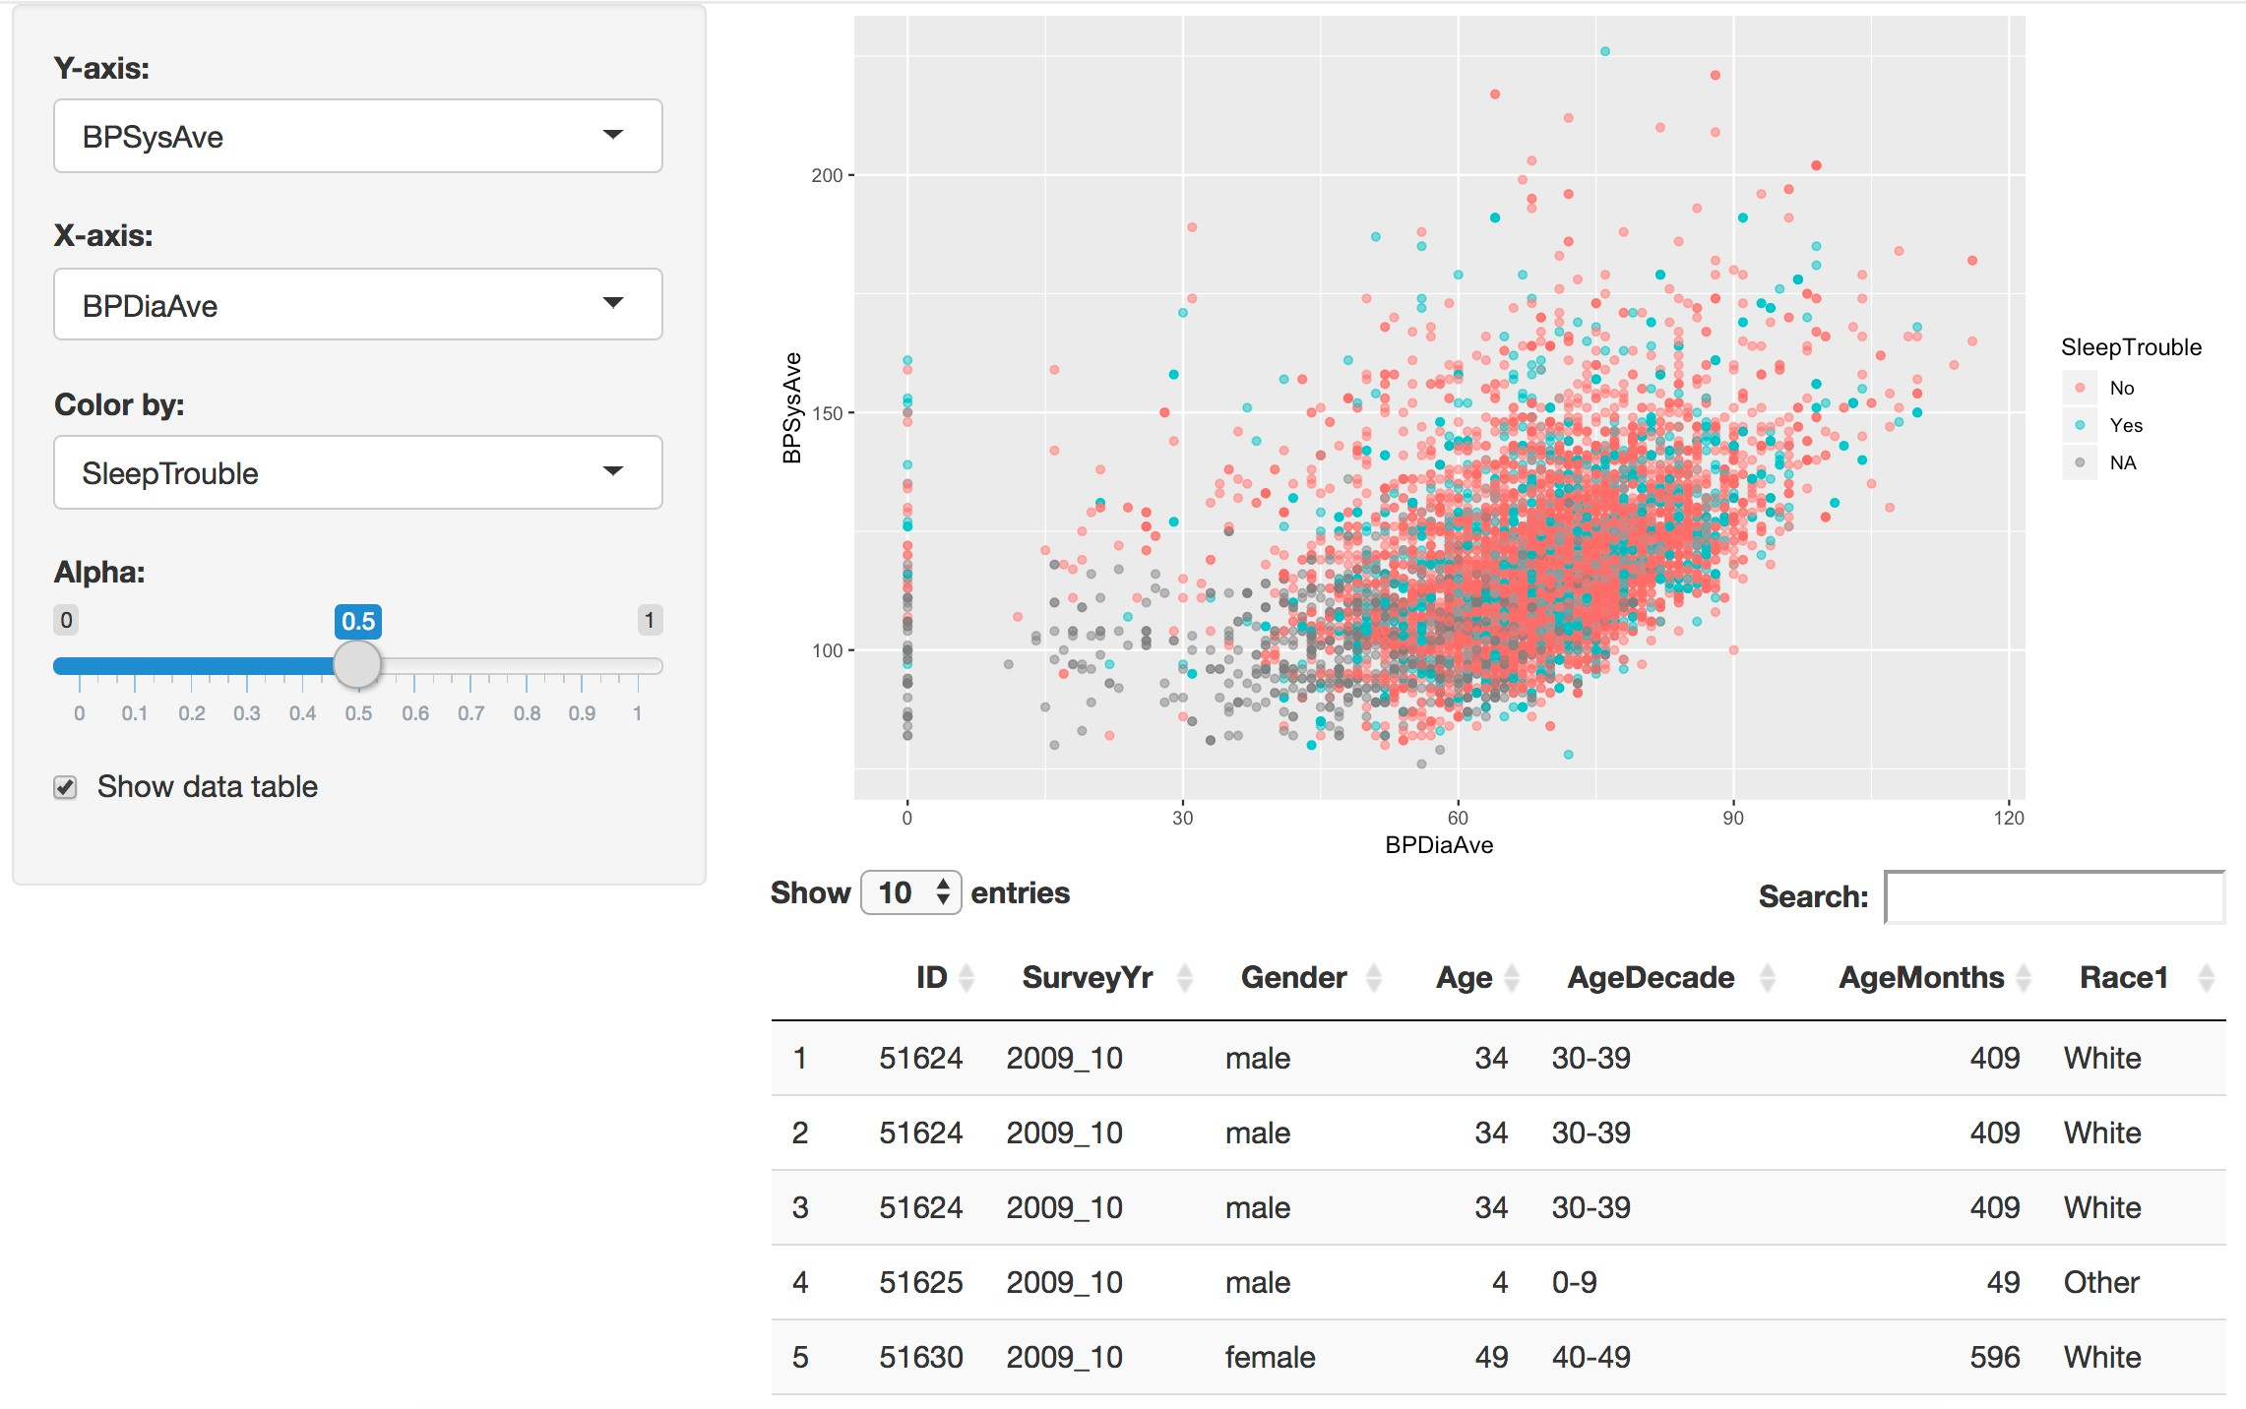

Which render* and *Output function duo is used to add this table to the app?
?

Slide 44
library(shiny) library(tidyverse) library(NHANES)
ui <- fluidPage(
DT::dataTableOutput()
)
server <- function(input, output) {
DT::renderDataTable()
}
shinyApp(ui = ui, server = server)

Slide 45

Your Turn
Create a new output item using DT::renderDataTable.
Show first seven columns of NHANES data, show 10 rows at a time, and hide row
names, e.g.
- data = NHANES[, 1:7]
options = list(pageLength = 10)
rownames = FALSE
Add a DT::dataTableOutput to the main panel
Run the app in a new Window
Compare your code / output with the person sitting next to / nearby you
Stretch goal: Make the number of columns visible in the table a user defined input

Slide 46
Solution to the previous exercise
nhanes-apps/nhanes-04.R
SOLUTION

Slide 47
Execution

Slide 48
Where you place code in your app will determine how many times they are run (or re-run), which will in turn affect the performance of your app, since Shiny will run some sections your app script more often than others.
library(shiny) library(tidyverse) library(NHANES)
ui <- fluidPage(
...
Run once when app is launched
)
server <- function(input, output) {
output$x <- renderPlot({
...
})
}
shinyApp(ui = ui, server = server)

Slide 49
library(shiny) library(tidyverse) library(NHANES)
ui <- fluidPage(
...
)
Run once
each time a user visits the app
server <- function(input, output) {
output$x <- renderPlot({
...
})
}
shinyApp(ui = ui, server = server)

Slide 50
library(shiny) library(tidyverse) library(NHANES)
ui <- fluidPage(
...
)
server <- function(input, output) {
Run once
each time a user changes a widget that output$x depends on
output$x <- renderPlot({
...
})
}
shinyApp(ui = ui, server = server)

Slide 51
File structure

Slide 52
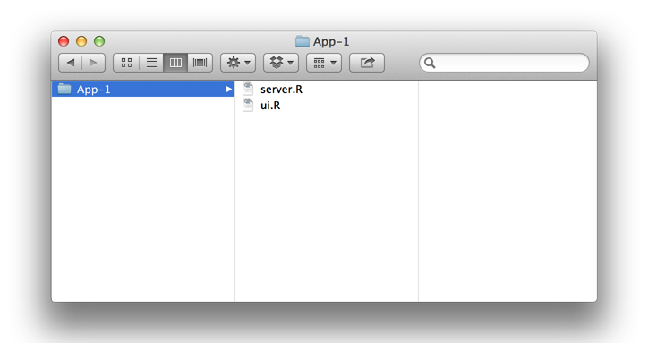
Single ﬁle
One directory with every file the app needs:
app.R - your script which ends with a call to shinyApp()
datasets, images, css, helper scripts, etc.
app.R
We will focus on the single file format throughout the workshop
You must use this
exact name (app.R)
for deploying the app

Slide 53

Multiple ﬁles
One directory with every file the app needs:
ui.R and server.R
datasets, images, css, helper scripts, etc.
must use these
exact names
ou
Y

Slide 54
Deploying your app

Slide 55
shinyapps.io
A server maintained by RStudio
Easy to use, secure, and scalable
Built-in metrics
Free tier available

Slide 56
Shiny Server
Free and open source
Deploy Shiny apps to the internet
Run on-premises: move computation closer to the data
Host multiple apps on one server
Deploy inside the firewall

Slide 57
Shiny Server Pro / RStudio Connect
Secure access and authentication
Performance: fine tune at app and server level
Management: monitor and control resource use
Direct priority support

Slide 58
Reactivity 101

Slide 59
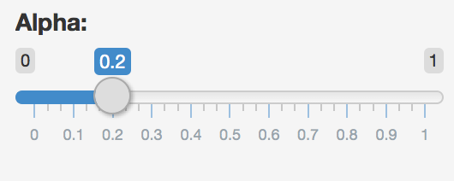
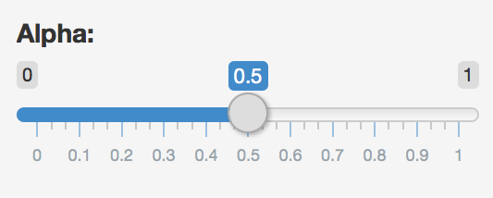
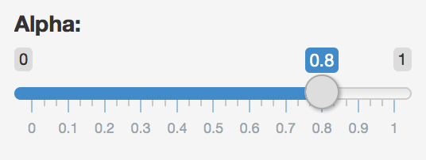
Reactions
The input$ list stores the current value of each input object under its name.
input$alpha = 0.2
# Set alpha level
sliderInput(inputId = "alpha",
label = "Alpha:",
min = 0, max = 1,
value = 0.5)
input$alpha = 0.5
input$alpha
input$alpha = 0.8

Slide 60
Reactivity 101
Reactivity automatically occurs when an input value is used to render an output object
# Define server function required to create the scatterplot server <- function(input, output) {
# Create the scatterplot object the plotOutput function is expecting output$scatterplot <- renderPlot(
ggplot(data = NHANES, aes_string(x = input$x, y = input$y,
color = input$z)) + geom_point(alpha = input$alpha)
)
}

Slide 61
Reactive ﬂow

Slide 62
Suppose you want the option to plot only certain education level(s) as well as report how many such participants are plotted:
Add a UI element for the user to select which education level(s) they want to plot
Filter for chosen education level(s) and save as a new (reactive) expression
Use new data frame (which is reactive) for
plotting
Use new data frame (which is reactive) also for reporting number of observations
DEMO

Slide 63
1. Add a UI element for the user to select which education level(s) they want to plot
# Select which education level(s) to plot checkboxGroupInput(inputId = "education",
label = "Select education level(s):”, choices = levels(NHANES$Education), selected = "College Grad")

Slide 64
2. Filter for chosen education level(s) and save as a new (reactive) expression
# | Server
# | Create | a | subset | of | data | filtering | for | chosen | educ
Creates a cached expression that knows it is out of date when input changes
ation level(s)
NHANES_subset <- reactive({ req(input$education)
filter(NHANES, title_type %in% input$education)
})

Slide 65
3. Use new data frame (which is reactive) for plotting
# Create the scatterplot object the plotOutput function is expecting
output$scatterplot <- renderPlot({ ggplot(data = NHANES_subset(), aes_string(x
co
geom_point(…) +
…
})
Cached - only re-run when inputs change
= input$x, y = input$y,
lor = input$z)) +

Slide 66
4. Use new data frame (which is reactive) also for printing number of observations
# UI
mainPanel(
…
# Print number of obs plotted uiOutput(outputId = "n"),
…
)
# Server
output$n <- renderUI({
types <- NHANES_subset()$title_type %>% factor(levels = input$selected_type)
counts <- table(types)
HTML(paste("There are", counts, input$selected_type, “participants in this dataset.<br>"))
})

Slide 67
Putting it altogether
nhanes-apps/nhanes-05.R
DEMO
Also notice
- HTML tags for visual separation
- req()

Slide 68
When to use reactives
By using a reactive expression for the subsetted data frame, we were able to get
away with subsetting once and then using the result twice
In general, reactive conductors let you
not repeat yourself (i.e. avoid copy-and-paste code) which is a maintenance boon)
decompose large, complex (code-wise, not necessarily CPU-wise) calculations into
smaller pieces to make them more understandable
These benefits are similar to what happens when you decompose a large complex R script into a series of small functions that build on each other

Slide 69
Suppose we want to plot only a random sample of participants, of size determined by the user. What is wrong with the following?
?
# Server
# Create a new data frame that is a sample of n_samp # observations from NHANES
NHANES_sample <- sample_n(NHANES_sample(), input$n_samp)
# Plot the sampled participants output$scatterplot <- renderPlot({
ggplot(data = NHANES_sample,
aes_string(x = input$x, y = input$y,
color = input$z)) +
geom_point(…)
})

Slide 70
# Server
# Create a new data frame that is a sample of n_samp # observations from NHANES
NHANES_sample <- reactive({
req(input$n_samp) # ensure availability of value sample_n(NHANES_sample(), input$n_samp)
})
# Plot the sampled participants output$scatterplot <- renderPlot({
ggplot(data = NHANES_sample(), aes_string(x = input$x,
SOLUTION
y = input$y,
color = input$z)) +
geom_point(…)
})

Slide 71
Render functions

Slide 72
Render functions
render*({ [code_chunk] })
Provide a code chunk that describes how an output should be populated
The output will update in response to changes in any reactive values or reactive expressions that are used in the code chunk

Slide 73
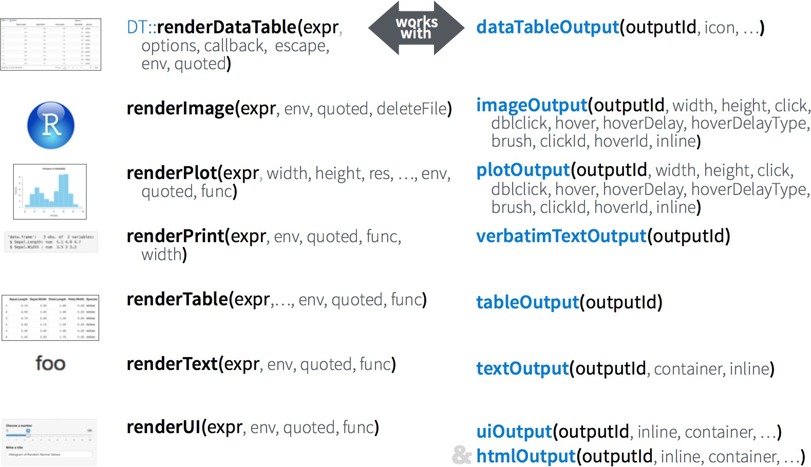

Slide 74
Recap
render*({ [code_chunk] })
These functions make objects to display
Results should always be saved to output$
They make an observer object that has a block of code associated with it
The object will rerun the entire code block to update itself whenever it is invalidated

Slide 75
Implementation

Slide 76
Implementation of reactives
Reactive values – reactiveValues():
e.g. input: which looks like a list, and contains many individual reactive values that are set by
input from the web browser
Reactive expressions – reactive(): they depend on reactive values and observers depend on
them
Can access reactive values or other reactive expressions, and they return a value
Useful for caching the results of any procedure that happens in response to user input
e.g. reactive data frame subsets we created earlier
Observers – observe(): they depend on reactive expressions, but nothing else depends on them
Can access reactive sources and reactive expressions, but they don’t return a value; they are used
for their side effects
e.g. output object is a reactive observer, which also looks like a list, and contains many individual
reactive observers that are created by using reactive values and expressions in reactive functions

Slide 77
Reactive expressions vs. observers
Similarities: Both store expressions that can be executed
Differences:
Reactive expressions return values, but observers don’t
Observers (and endpoints in general) eagerly respond to reactives, but
reactive expressions (and conductors in general) do not
Reactive expressions must not have side effects, while observers are only
useful for their side effects

Slide 78
shinythemes

Slide 79
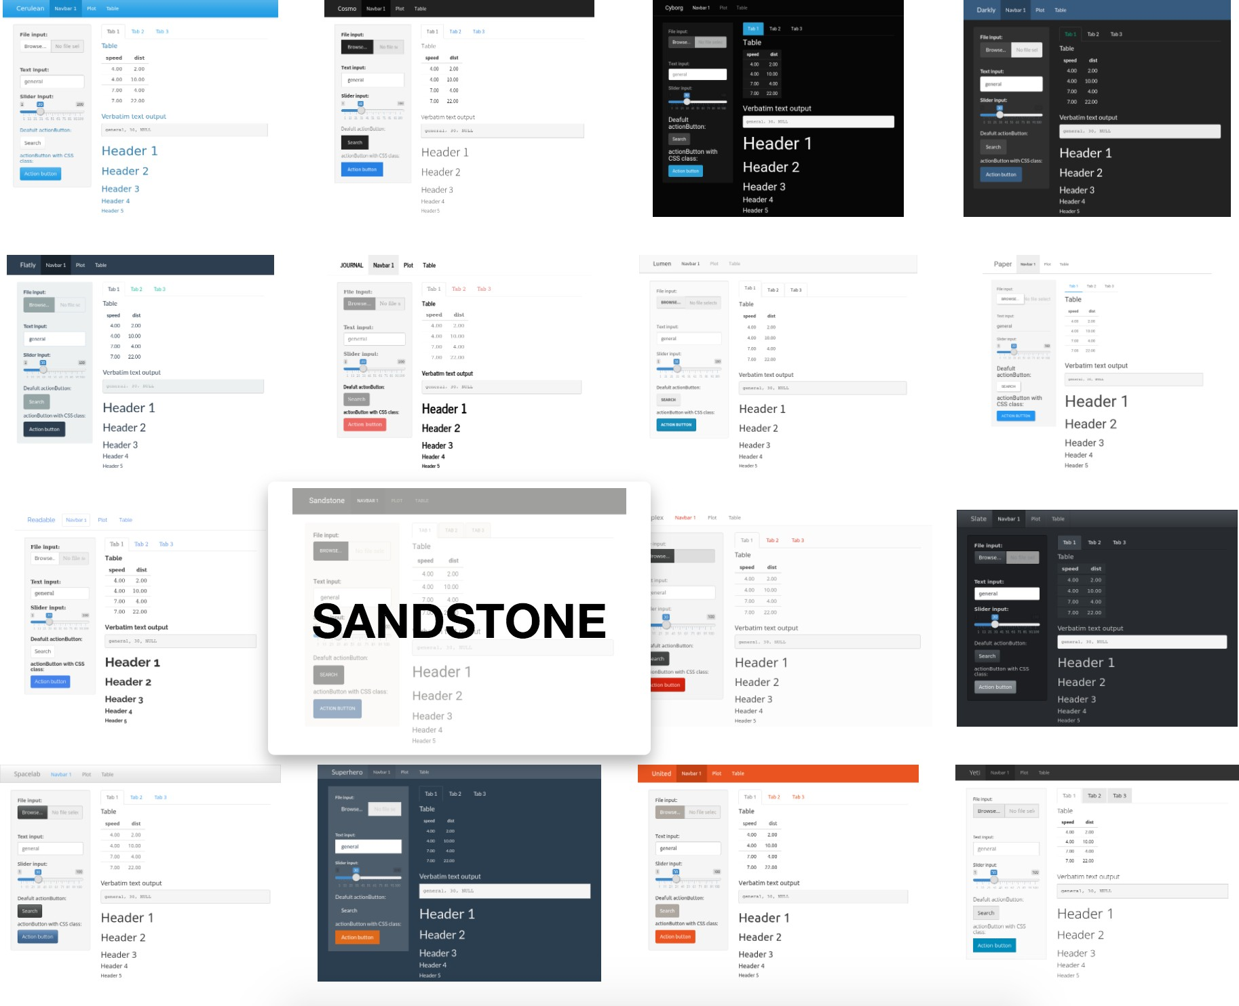

Slide 80
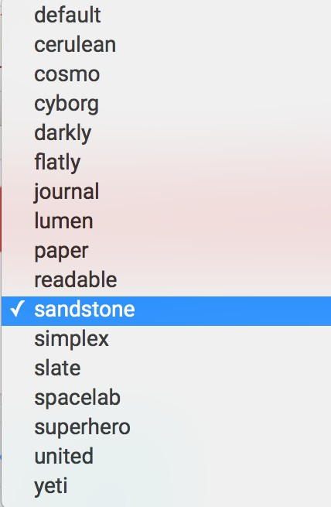
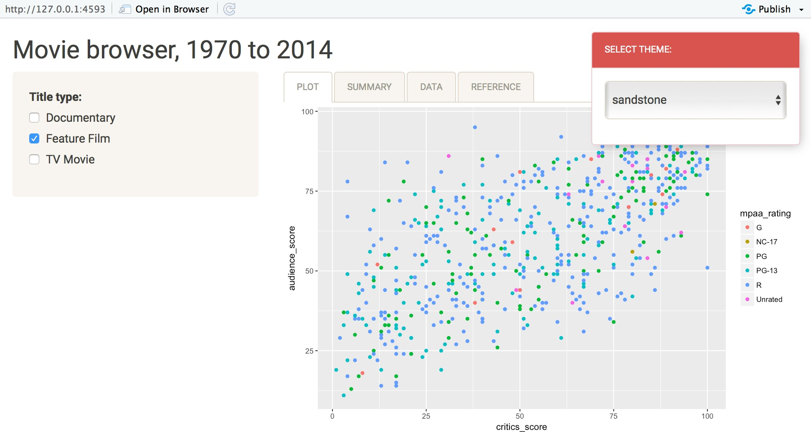
shinythemes
library(shiny) library(shinythemes)
ui <- fluidPage( themeSelector(),
…
)

Slide 81
shinydashboard

Slide 82
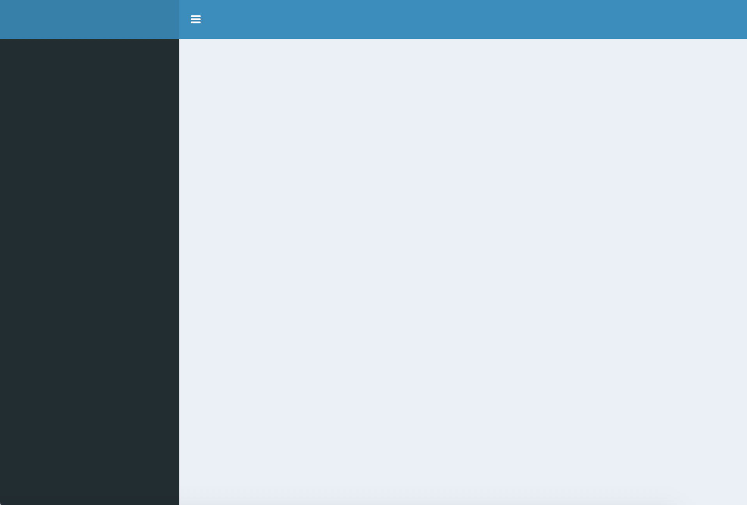
header
sidebar
body

Slide 83
library(shiny) library(shinydashboard)
User interface
controls the layout and appearance of dashboard
ui <- dashboardPage( dashboardHeader(), dashboardSidebar(), dashboardBody()
)
Server function
contains instructions needed to build dashboard
server <- function(input, output) { }
shinyApp(ui, server)

Slide 84
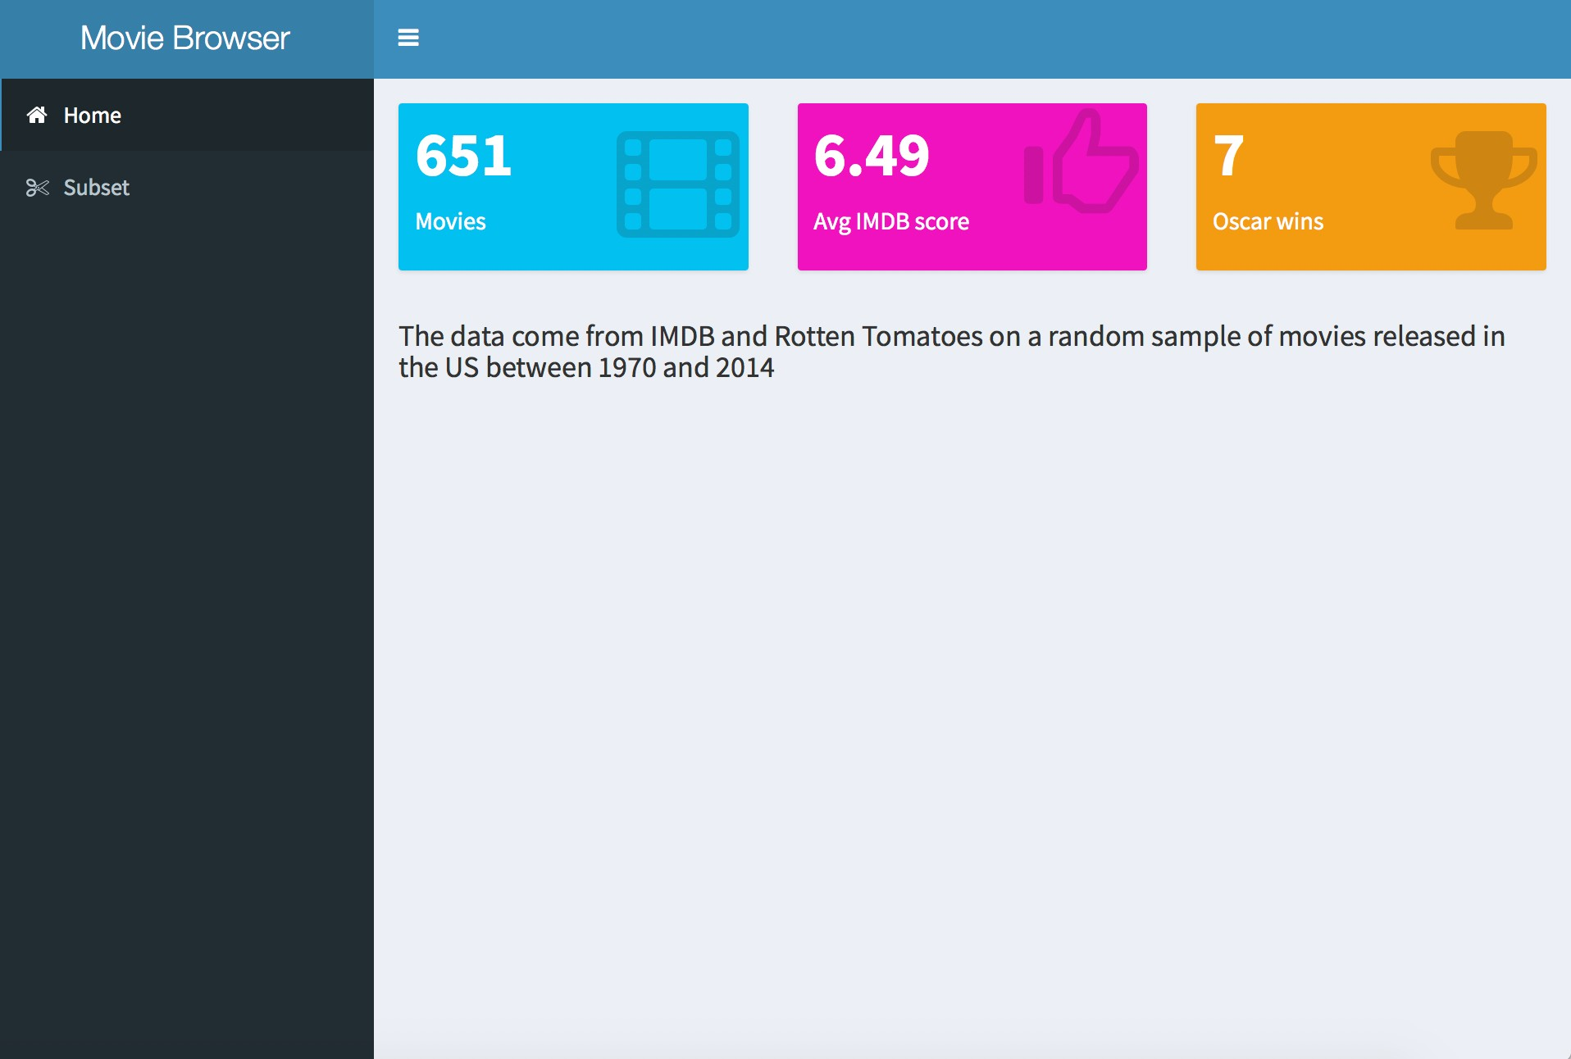

Slide 85
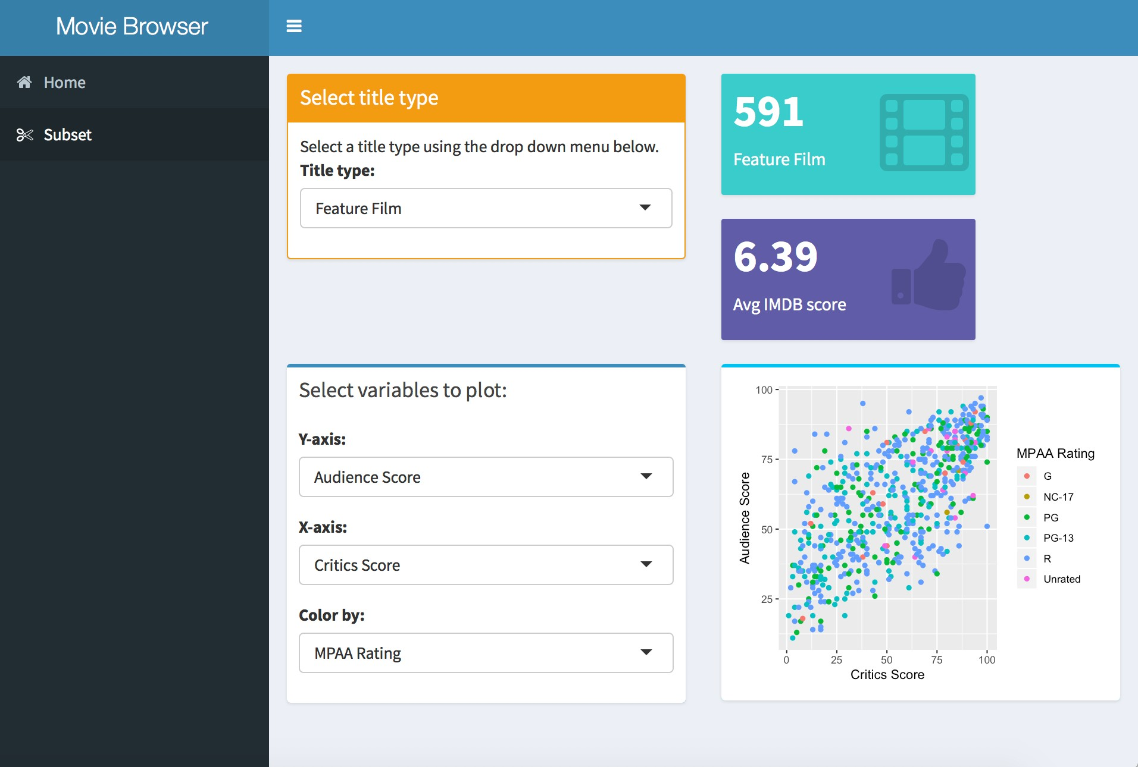

Slide 86
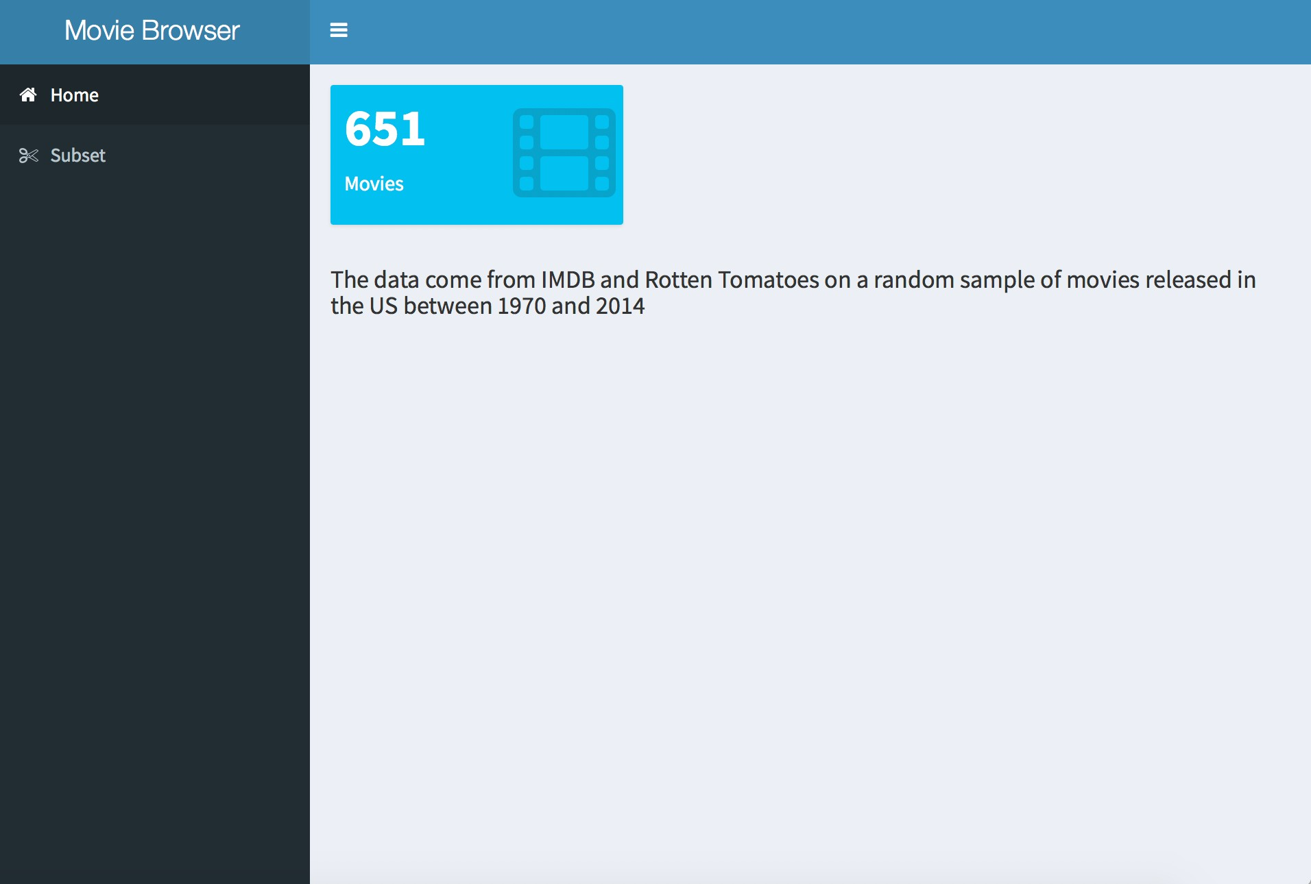
dashboards/moviedash-01.R
DEMO

Slide 87
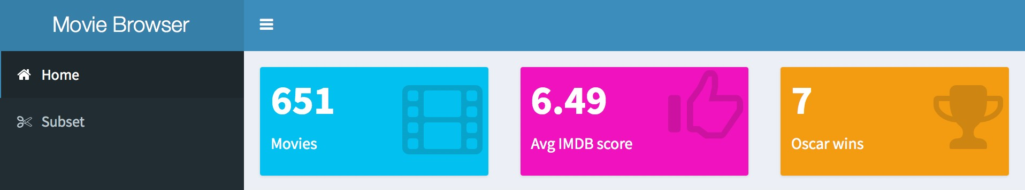
Your turn
Start with dashboards/moviedash-01.R
Add two more value boxes: average IMDB rating and number of Oscar wins
Try to match the colors and icons as well

Slide 88
dashboards/moviedash-02.R
SOLUTION

Slide 89
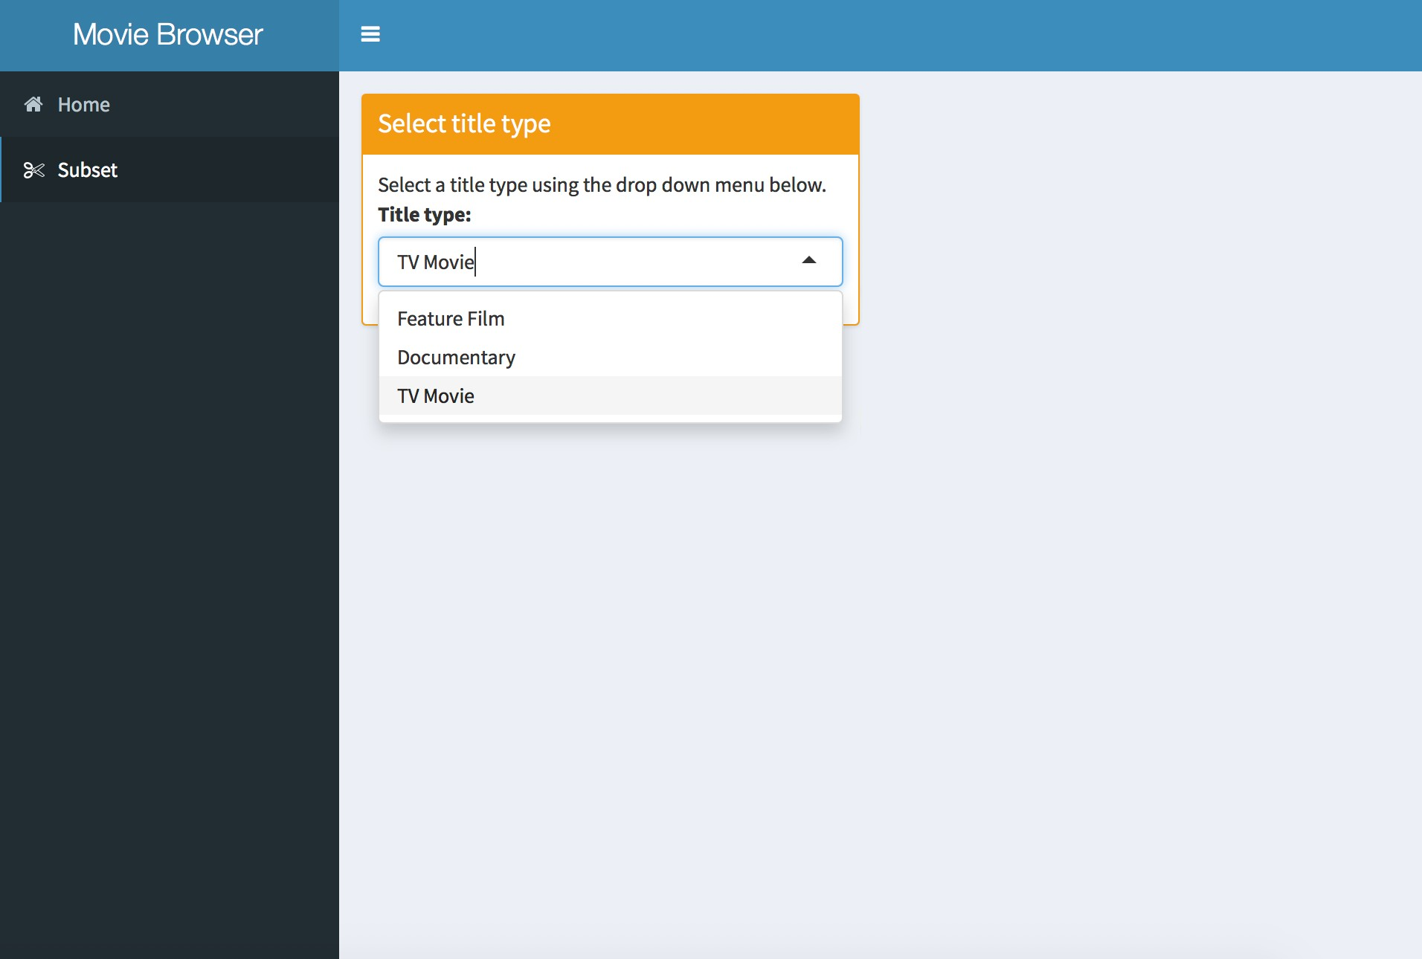
dashboards/moviedash-03.R
DEMO

Slide 90
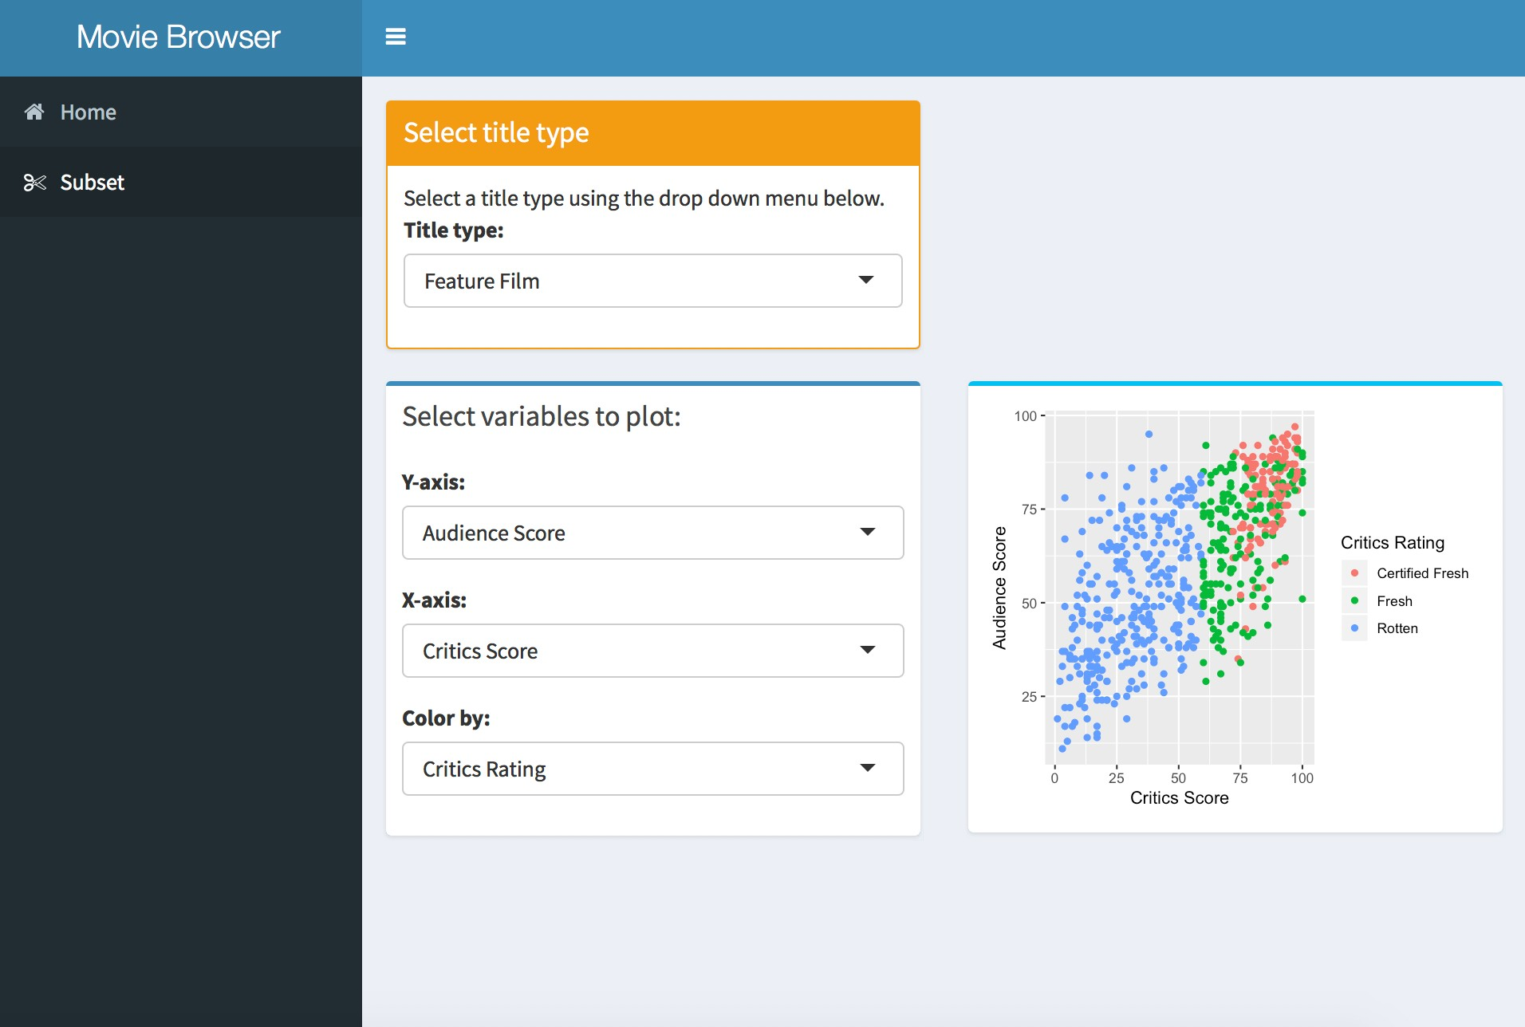

Your turn
Start with dashboards/
moviedash-04.R
Fill in the blanks to achieve the look / functionality on the right
You can re-use code from earlier

Slide 91
dashboards/moviedash-05.R
SOLUTION

Slide 92
dashboards/moviedash-06.R
DEMO

